Slide 1

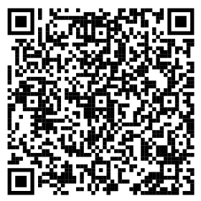


How to ensure halal and healthy eating in Germany?
Join PSA-KA Organized Workshop: "How to ensure halal and healthy eating in Germany?"
Are you concerned about halal options in Germany? Do you want to know the basics about the health aspect of food?
Join us for an insightful workshop where we'll cover essential background and tips to help you explore halal and healthy eating options in Deutschland.
Workshop Highlights:
Understanding the basics of healthy food with general facts and figures
Difference between various halal tags and choosing a better one
Valuable tips from personal experience in Germany
Halal and healthy options available in common supermarkets
Question/answer session
This is going to be an informative workshop. What you choose to eat is completely your decision and we respect that.
The meeting is intended for Muslim newcomers in Germany and can be joined by Muslims of any nationality.
We look forward to seeing you in the workshop!
Date: 19.11.2023
Time: 14:00 CET
Meeting Link: https://kit-lecture.zoom-x.de/j/64903404408?pwd=aHZzMGViUStVVkdadUpHUk04TzI2QT09
For more information, you can visit our webpage: https://github.com/enggsajjad/psa
Also, show us your support by following our YouTube channel: https://www.youtube.com/@PSA-KA
Meeting code

